Slide 1

Working With AI Tools
Session – 1

Slide 2
Agenda
Prompt Engineering
Anatomy of Effective Prompts
Core Prompting Techniques
Controlling of Prompt Output
Debugging and Iteration
Hands on Lab – Reduce Hallucinations, Common Pitfalls

Slide 3
Prompt Engineering
Navigating the future

Slide 4
How LLMs read a Prompt
To build a highly accurate model with LLM, the relationship between Tokens, Context Window management, and Prompt Engineering should be optimized
An accurate model relies on maximizing the signal-to-noise ratio within the context window while phrasing prompts in a way that aligns with how the LLM computes probabilities.

Slide 5

Token Optimization & Cost Efficiency
Unlocking new horizons

Slide 6

The Token Ratio – 100 English words ~ 130 Tokens. Non-English words, code blocks and special characters take up more tokens per word.
Granular Tracking – Monitor the input token count with Token Library e.g. OpenAI supports tiktoken or anthropic-tokenizer (Claude).
Stop Sequences – Implementation of explicit stop token to prevent unnecessary fillers to overcome wastage of tokens and output precision
LLMs don’t read words, they process word fragments called Tokens

Slide 7
Context Window Management
Total Memory space available between input prompt and output
The ‘Lost in Middle’ phenomenon
  Give general information about this topic to add depth and clarity. Write short, interesting reference points that don’t need to be read aloud.​
Add a subtitle
  Give general information about this topic to add depth and clarity. Write short, interesting reference points that don’t need to be read aloud.​
Add a subtitle​
  Give general information about this topic to add depth and clarity. Write short, interesting reference points that don’t need to be read aloud.​

Slide 8
Anatomy of Effective
Prompt
An effective prompt functions like a project brief for a smart teammate
it eliminates ambiguity by providing exact boundaries and instructions.
Effective Prompt = Role + Context + Task + Constraints + Output Format + Examples
Who it should act as
Role
Direct Action
Task
Background Info
Context
Output format
Exact Visual or Structured Shape
8

Slide 9

The 6 Core Building Blocks
Role(Persona)
Context
Task(Instruction)
Constraints
Output format
Examples (Few-shot)
9

Slide 10
3 Rules for Prompt Mastery
Order Matters -> Lead with the Role, then the Task, followed by Context, Constraints, and finally the Format
Be Specific, Not Verbose -> Adding random filler words confuses the engine. Priorities precise adjectives, exact numeric constraints
Prompting is essential -> Treat it as an iterative process—start broad, analyze the AI's response, and chip away at it by feeding it follow-up constraints or clarifications

Slide 11
The Reusable Template
Reusable prompt templates turn successful, ad-hoc AI interactions into reliable workflows by separating stable instructions from dynamic runtime variables.
A bulletproof prompt template for a recurring task maps out a five-part framework: Role → Task → Context → Format → Constraints.
11

Slide 12
Steps to build Prompt Library
[Identify Tasks] ➔ [Isolate Variables] ➔ [Establish Guardrails] ➔ [Test & Refine]
Audit Your Routine: Review your daily or weekly workload. Anything you have prompted an AI to do more than twice this month (e.g., status reports, content generation, data extraction) is a prime candidate for a template.
Isolate the Variables: Clearly separate your static core logic from the user data that changes per request. Use distinct variable markers like {variable_name} or [VARIABLE_NAME].
Establish Guardrails: Define explicit fallback rules for the model. Tell it exactly what to do if an input variable is missing, incomplete, or ambiguous (e.g., "If no tone is specified, default to professional" or "If the data is missing, reply with 'Information not provided' instead of guessing").
Validate on Multiple Inputs: Never put a template into a production pipeline or shared team library based on a single successful output. Test the template on at least 3 distinct sets of input data to ensure it doesn't break under different edge cases.

Slide 13
Core Prompting Techniques
Zero-Shot vs. Few-Shot Prompting
Few-Shot Prompting

Slide 14

Zero-Shot Prompting

Slide 15
Contrast Framework
Zero-Shot: "Classify this customer review as Positive, Neutral, or Negative: 'The product arrived on time but the packaging was slightly torn, though the item itself works perfectly.'".
Few-Shot: Provide explicit examples first to lock in the formatting..
15

Slide 16
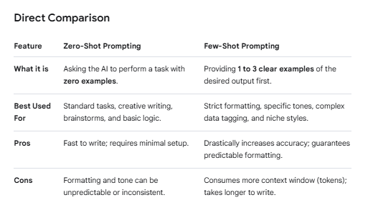
Zero-shot prompting asks an AI to complete a task without showing it any examples, while few-shot prompting provides 1 to 3 examples of the exact input-output structure you want before giving the final prompt.

Slide 17
Zero Shot Example (no Guidance)
Prompt: Classify this support ticket as Technical, Billing, or General: "My screen goes entirely black every time I try to open the export menu."
Likely AI Output: This support ticket falls under the Technical category because it describes an application crash/UI failure when triggering an explicit software action (the export menu).

Slide 18
Few-Shot Example (Pattern Lock-in)
Prompt:
Classify the support tickets below. Follow the formatting of the examples exactly.
Ticket: "I need to update my credit card on file."
Category: BILLING
Ticket: "Where can I find the company holiday calendar?"
Category: GENERAL
Ticket: "My screen goes entirely black every time I try to open the export menu."
Category:
Likely AI Output: TECHNICAL

Slide 19
Scenario to Zero-shot and Few-shot
Choose Zero-Shot when: You are using a highly capable model (like GPT-4o or Claude 3.5 Sonnet) for everyday text generation, brainstorming ideas, translating simple phrases, or writing emails where the precise structure isn't critical.
Choose Few-Shot when: You need the output to match a highly specific corporate voice, you are generating code that must fit a rigid syntax, or you are extracting data into a clean structure (like JSON or CSV arrays) to pass into another software application.

Slide 20
Controlling the Output
Controlling output format is the difference between copy-pasting an AI's response directly into your workflow and spending 15 minutes formatting it yourself.
Markdown & Tables
Markdown is the universal language of AI formatting. It allows you to enforce clean hierarchies using headers (#, ##), bold text (**), and structured data grids. Tables are ideal for direct comparisons, features, or metrics.

Slide 21
Power of Structured Output
2. Enforcing JSON forces the model to drop all conversational text and output raw code.
Two Rules for Flawless Output Control
Use Negative Constraints (The "Do Not" Rule): Models are eager to please and will often add polite conversational filler. You must explicitly forbid it.
  Good: "Provide only the raw markdown list. Do not include introductory or concluding remarks."
Provide a Blank Target: When asking for a specific format, leave a structural placeholder at the very end of your prompt to signal to the model exactly where its text should begin.

Slide 22
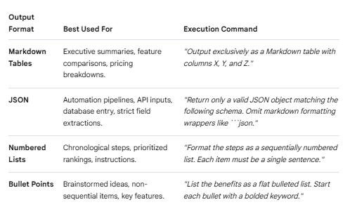
Scenario to use Markdown Vs JSON

Slide 23
Controlling Tone, Reading level and Length
Controlling Tone (The Emotional Frame)
Tone sets the attitude of the response. To get the exact voice you want, avoid vague words like "make it sound professional." Instead, provide contrasting guardrails.
The Command Strategy: Give the model a target tone along with an explicit "anti-tone" to avoid.
Write a reply to this customer complaint regarding a shipping delay.Tone: Empathetic, direct, and solutions-oriented. Anti-Tone: Do not sound overly defensive, stiffly corporate, or robotic. Do not use exclamation marks.

Slide 24
2. Controlling Reading Level
2. Controlling Reading Level (The Complexity Frame)
If you do not specify a reading level, AI models tend to write at a university or postgraduate level, using complex sentence structures and industry jargon. You can pin the model to a specific audience using the CEFR scale, grade levels, or clear structural rules.
Explain our new data privacy policy. Target a 12th-grade reading level. Use precise industry terms (GDPR compliance, data minimization) without over-simplifying, as this is for our legal and compliance stakeholders.

Slide 25
3. Controlling the Length
Models are notoriously bad at counting characters or exact words because they process text in "tokens" (chunks of characters), not words. Asking for "exactly 240 words" usually fails. Instead, enforce length using structural units that the model can track mathematically.
High-Leverage Length Constraints
Paragraph/Sentence Counts: "Write exactly two paragraphs. The first paragraph must contain three sentences, and the second must contain two."
Hard Hard Ceilings: "Keep the entire response under 50 words total."
Visual/Layout Caps: "Provide exactly three bullet points. Each bullet point must be a single line of text and contain no more than 10 words."

Slide 26
Constraining scope to prevent rambling or off-topic answers
To keep an AI tightly focused and prevent it from rambling, hallucinating, or wandering off-topic, you must establish strict operational boundaries.
Prevent Rambling
Use "Negative Prompting" (What Not to Do)
Explicitly stating what the AI should omit is often more powerful than telling it what to include.
Instead of: "Keep it brief."
Use: "Do not introduce background history, adjacent theories, or introductory fluff. Answer the query directly in the first sentence."

Slide 27
2. Implement Structural Hard Caps
Force the AI into a strict structural container. When the model has to fit its thoughts into a rigid visual format, it naturally cuts out filler text.
Instead of: "Write a summary."
Use: "Provide exactly three bullet points. Each bullet point must be a single sentence fragment of no more than 15 words. Do not write a concluding paragraph.

Slide 28
3. Anchor the Source Data
Prevent the AI from pulling from its general internet knowledge base by locking it down to a specific set of facts.
Instead of: "Tell me about X based on standard practices."
Use: "Rely exclusively on the text provided below. If the answer cannot be found directly within the text, state 'Information not available' and stop writing. Do not extrapolate."

Slide 29
4. Define the Exact "Scope of Expertise"
Give the AI a narrow identity that naturally limits its vocabulary and perspective.
Instead of: "Act as a business consultant."
Use: "Act as a strict compliance auditor. Your scope is limited entirely to identifying regulatory violations in the text. Ignore operational efficiency, marketing, or revenue suggestions."

Slide 30
5. Use Trigger Words for Directness
Incorporate command verbs that explicitly demand brevity.
Good target phrases: "Be concise," "Provide an executive summary," "Give a stark, minimalist breakdown," "Answer in a single word/phrase."

Slide 31
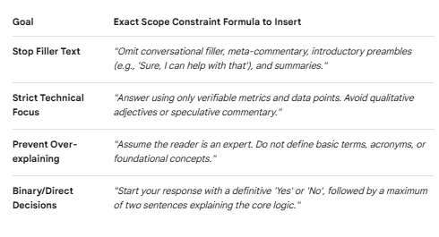
Constraint Blueprint

Slide 32
Iteration and Debugging
To systematically improve a prompt, use this cyclical debugging process:
Test Baseline: Run your prompt 3 to 5 times on different inputs to see if the output is consistently flawed or just a one-off variance.
Isolate Failure: Identify exactly where it broke. Did it break format? Did it ramble? Did it misunderstand a specific word?
Patch Prompt: Apply a specific constraint or an example (few-shot template) to show the AI exactly what correct looks like.
Stress Test: Push the prompt to its limits with edge cases (e.g., feeding it intentionally messy data) to ensure your patch holds up.

Slide 33
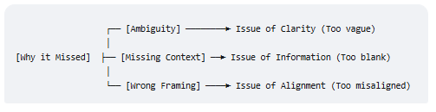
The post-mortem of response missing
When an AI model delivers a frustrating or useless response, it usually stems from one of three structural flaws in your prompt. Diagnosing the exact root cause tells you exactly how to patch it.

Slide 34
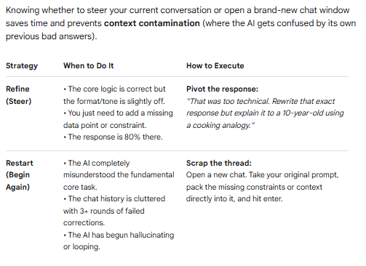
Refine vs. Restart: The Decision Matrix

Slide 35
Smart Prompt Storage Strategy
Create "Modular Elements": Instead of saving massive, static 500-word prompts, save reusable components. Have a library of your favorite Personas, your absolute strictest Formatting Constraints, and your cleanest Few-Shot Examples. You can then mix and match them like LEGO bricks depending on your task.
Tag by Intent: Organize your library using simple functional tags like #summarization, #code-review, #copywriting, or #data-extraction so you can find your blueprints instantly.

Slide 36
Questions

